Slide 1
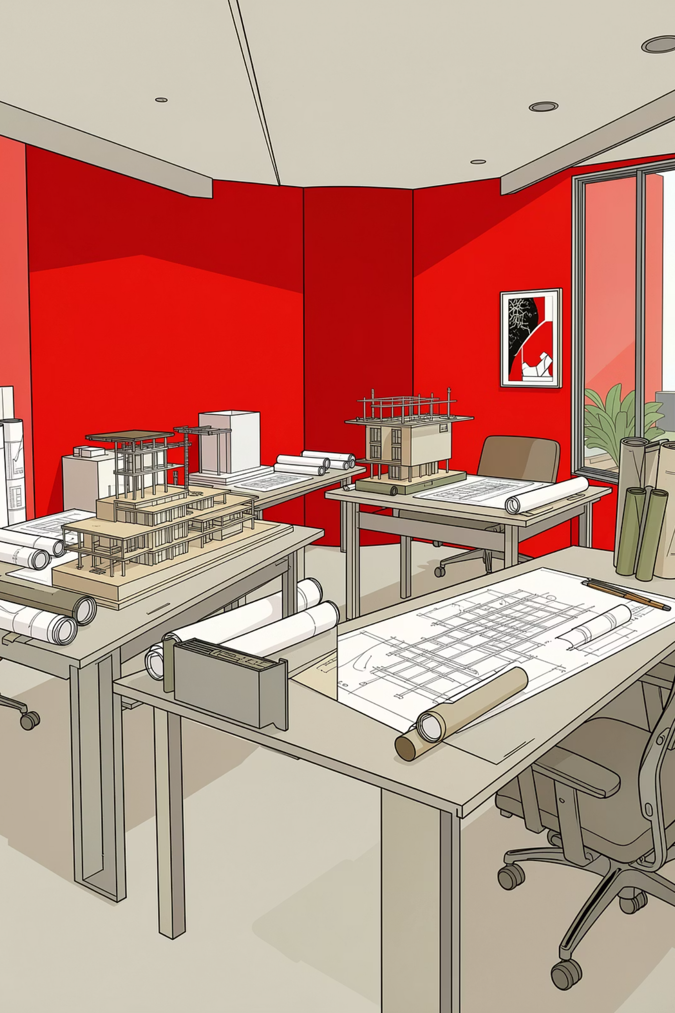
DURO Design Group
Website Design Proposal
Two-Tier Modern Web Package — Next.js + AI-Enabled
Starting at $3,500
Prepared by The Livingstone Solution | April 2026
Up to ~75% off standard agency rates
Confidential — For DURO Leadership Only
Every build ships within 7 weeks or less

Slide 2



The Digital Gap
DURO is a credible, award-winning A+E firm with a real portfolio — Eastern Market, Walter Pierce Park, Thurgood Marshall Center, African American Civil War Museum, Harbor Bank of Maryland HQ — and the 2024 ULI Wavemaker Award.
⚠️ None of it is visible online today.
DURO Digital Maturity
0.5
Out of 10
DURO's current digital score
Competitor Range
EHT Traceries: 6.0 / 10
Hickok Cole: 9.0 / 10
Every direct peer has a working website — DURO is the outlier
Procurement officers at DGS, DDOT, DC Water cannot find DURO when they search
Three Objectives for the Website
Make DURO Discoverable
Tell the A+E Story
Rank Everywhere
Rank on Google and AI search engines
Showcase the integrated architecture and engineering portfolio
Google AND AI search — ChatGPT, Perplexity, Claude, Gemini

Slide 3

The Stack — Next.js + AI
We build on a modern web stack. No WordPress. No Webflow. Every DMV competitor runs on outdated templates — DURO will be the most technically capable architecture-firm website in the DMV.
Core Framework
Why This Matters for DURO
Every DMV peer we benchmarked runs on WordPress or off-the-shelf platforms
The stack is future-proof — when DURO wants to add features later, we add modules, never rebuild
AI-native from day one — GEO and advanced features require a modern JavaScript stack
Next.js 14 + TypeScript
Tailwind CSS
Design-system-first styling, brand-consistent everywhere
The framework behind Notion, TikTok, OpenAI
Headless CMS
Vercel + Edge Network
GEO and AI features are effectively impossible on WordPress — they require this stack.
Payload or Sanity — DURO's team edits content, no code required
Sub-second load times globally

Slide 4
Two Tiers — At a Glance
Each tier is self-contained. Start at Tier 1, upgrade to Tier 2 later without rebuilding. The discount is intentional — DURO is our showcase client, we reuse our component system, and the long-term relationship lives in the $159/mo partnership retainer.
✅ Selected by DURO
Essential Presence
A credible online footprint, fast
$3,500
DURO Price
Market Rate: $10,000 – $15,000
~70% SAVINGS
TIER 2
Competitive Parity
Match EHT Traceries + Bell with AI search visibility
$6,400
DURO Price
Market Rate: $22,000 – $32,000
~75% SAVINGS

Slide 5

Tier 1 — Essential Presence | $3,500
✅ Selected by DURO
LIVE IN 3–4 WEEKS
MARKET RATE: $10,000–$15,000
Fast, credible, online in 3–4 weeks. Get DURO on the map with a professional, high-performance website that establishes your digital presence immediately.
Pages Included
What's Included
Home
About
Services
Projects
Contact
5 project case studies from your existing deck
Capabilities-statement download
Contact form piped to email
Basic SEO — Organization schema, sitemap, robots.txt
Google Business Profile claim at 5112 11th St NE
SAM.gov / AIA|DC / DSLBD CBE directory refresh checklist
Headless CMS — your team edits without code
30-minute training walkthrough
Performance
Mobile-responsive
Lighthouse 90+
WCAG AA basics
Hosting is separate via the $159/mo retainer. Upgrade to Tier 2 any time — no rebuild needed.

Slide 6

Tier 2 — Competitive Parity | $6,400
FUTURE UPGRADE PATH
MARKET RATE: $22,000–$32,000
6–7 WEEKS
Match EHT Traceries + Bell Architects. Add AI-search visibility. Everything in Tier 1, plus the features that put DURO on the competitive map.
8–10 Page Custom Site
GEO — AI Search Visibility
Full CMS, 8 project case studies with before/after galleries, renderings, and project facts. Dedicated Team page + per-discipline Services pages.
Structured so ChatGPT, Perplexity, Claude, and Gemini recommend DURO. The feature that makes this tier transformative.
Insights Hub
Full SEO + Analytics
Seeded with 3 launch articles we write — preservation, net-zero, and DGS procurement. Establishes DURO as a thought leader.
Keyword research, CreativeWork schema on case studies, Core Web Vitals. Google Analytics 4 + Search Console + monthly analytics emails.
Appointment Booking
LinkedIn + Content Calendar
Cal.com widget wired to your calendar. Clients book directly from the website.
Company page setup + 90-day content calendar with 12 posts. Press-kit page with ULI Wavemaker coverage.

Slide 7

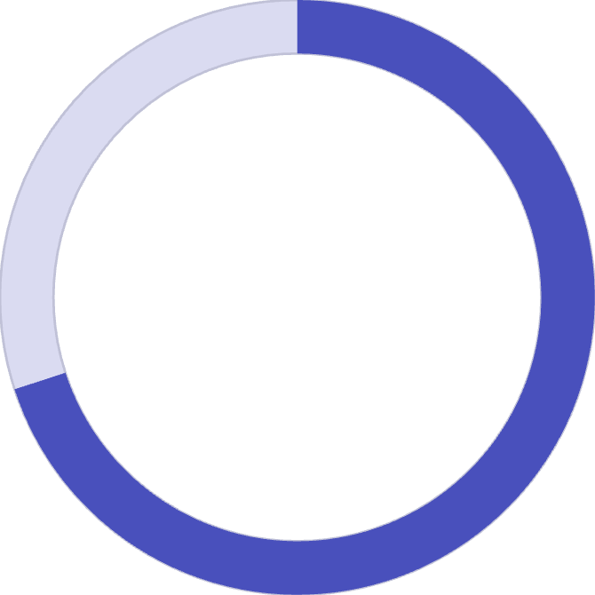
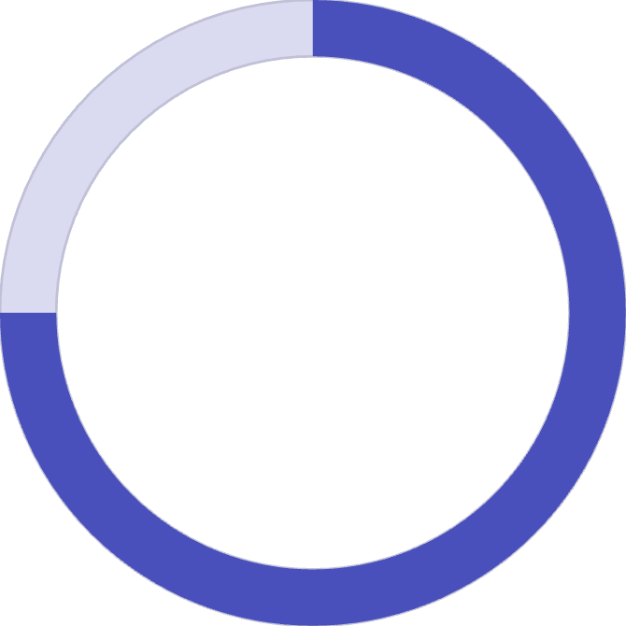
Market Rate vs. DURO Price
Typical DC agency quotes for a comparable Next.js build. The numbers speak for themselves.
Project Type
Market Quote
DURO Price
5-page Next.js site
$10,000 – $15,000
$3,500 (Tier 1)
Custom 10-page site + CMS + GEO
$22,000 – $32,000
$6,400 (Tier 2)
✅ The simple read: At Tier 1, DURO gets a credible Next.js site that would cost $10,000–$15,000 elsewhere — for $3,500. At Tier 2, a full competitive-parity build with GEO and content that agencies quote at $22,000–$32,000 — for $6,400. Either way, the highest-ROI marketing dollar DURO can spend in 2026.
70%
75%
Tier 1 Savings
Tier 2 Savings
vs. standard DC agency rates for a 5-page Next.js site
vs. standard DC agency rates for a full custom build with GEO

Slide 8

The Partnership Offer — $159/month
Optional. Starts only after launch, when DURO is satisfied with the project. Month-to-month. Cancel anytime.
What's Included
Hosting
Bug Fixes
Cybersecurity
Vercel + Supabase on our account. Global edge network, automatic SSL, backups. Historically >99.99% uptime.
If anything breaks, we fix it. Response within one business day.
Dependency updates, security patches, monitoring, WAF/CDN protection, vulnerability scans, incident response.
Why This Matters
Most agencies ship and disappear. DURO serves public-sector clients where a broken form or security incident at the wrong moment can cost a task-order win.
$159/mo means DURO never thinks about infrastructure — and the site keeps getting better.
Excludes: new features (quoted separately as a small SOW), content writing beyond minor edits.
$150
Per Month
Hosting + Bug Fixes + Cybersecurity. Month-to-month, cancel anytime.

Slide 9

Let's Build.
DURO has selected Tier 1 — Essential Presence ($3,500). This gets DURO online with a credible, fast-loading Next.js site in 3–4 weeks — discoverable by procurement officers, GC teaming partners, and recruits. When DURO is ready, upgrading to Tier 2 adds GEO, thought-leadership content, and full competitive parity — at an incremental cost, no rebuild required.
Next Steps
SOW + Deposit
We send a short SOW + invoice for the 50% deposit ($1,750)
Kickoff Call
Within 5 business days of signing
First Design Comp
Delivered in 7–14 days
Launch
Within 3–4 weeks. Training and handoff follow immediately.
Partnership
Optional $159/month retainer (hosting + bug fixes + cybersecurity) begins at launch
✅ SOW in your hands within 24 hours of confirmation.— The Livingstone Solution team

